Slide 1
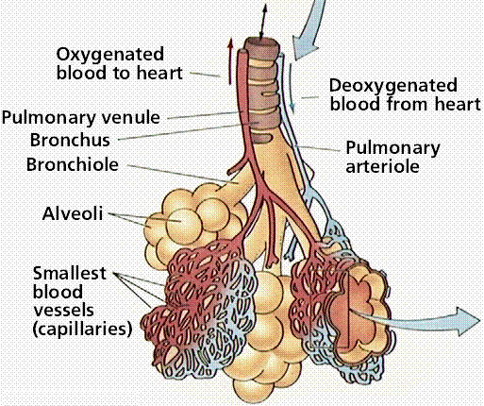

Slide 2
Gas Exchange: External Respiration
External respiration: the exchange of gases between air in the alveoli and blood in the pulmonary capillaries.
The pressure exerted by gases is called its partial pressure and is symbols are P_{O2} and P_{CO2}
High CO₂/ low O₂ blood is pumped from the right ventricle of the heart, through the pulmonary arteries, to the capillaries that surround each alveolus

Slide 3
4. Blood in the pulmonary capillaries has a higher P_{CO2} than the atmospheric air and therefore CO₂ diffuses out from the blood plasma and into the alveoli sacs
5. The air in the alveoli is high in oxygen (P_{O2}) so oxygen moves by diffusion from the alveoli into the blood capillaries
6. High O₂/ low CO₂ blood leaves the alveolar capillaries, through the pulmonary vein, to the left atrium of the heart

Slide 4
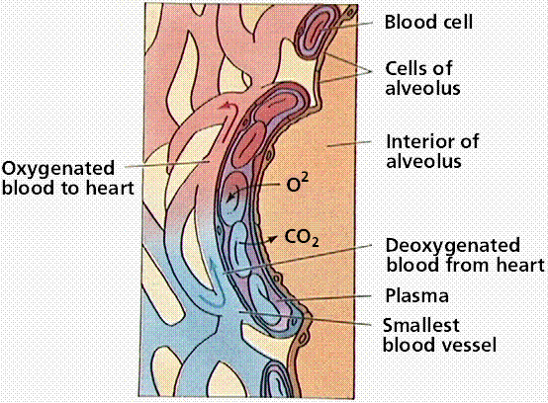

Slide 5
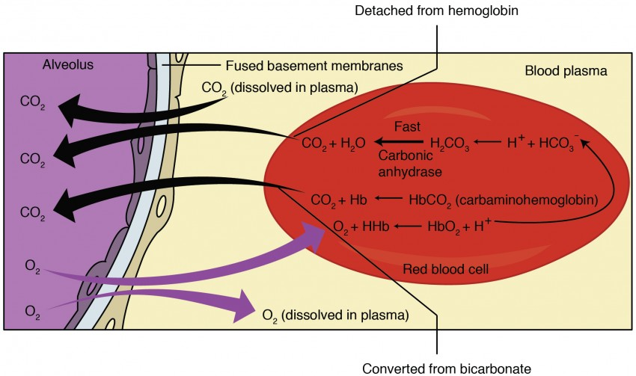

Slide 6
Gas Exchange: Internal Respiration
Internal Respiration refers to the exchange of gases between the blood in systemic capillaries and the tissue fluid.
The left ventricle pumps high O₂/ low CO₂ blood along the aorta and arteries to the capillaries that are in contact with individual cells
The blood in the body capillaries has more oxygen than the body cells, so oxygen diffuses from the blood into the body cells
The body cells have more carbon dioxide than the blood, so carbon dioxide diffuses from the body cells into the blood in the body capillaries
High CO₂/ low O₂ blood leaves the body capillaries, travels through veins and the vena cava to the right atrium

Slide 7
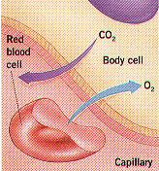

Slide 9
Chemistry of Gas Exchange
Oxygen
<5% of oxygen travels in blood as a dissolved gas
>95% of oxygen travels in blood attached to hemoglobin (HbO₂)
(oxyhemoglobin)
Carbon Dioxide
10% of carbon dioxide travels in blood as dissolved gas
20% of carbon dioxide travels in blood attached to hemoglobin (HbCO₂) (carbaminohemoglobin)
70% of carbon dioxide reacts with water in blood plasma to form the bicarbonate ion (HCO₃⁻)

Slide 10
Hemoglobin
Hemoglobin preferentially binds oxygen over carbon dioxide (but oddly, binds carbon monoxide preferentially over oxygen!)
1 hemoglobin molecule is able to bind 4 oxygen molecules
Because of hemoglobin our blood can carry 70x more oxygen than it would as a dissolved gas in plasma

Slide 11
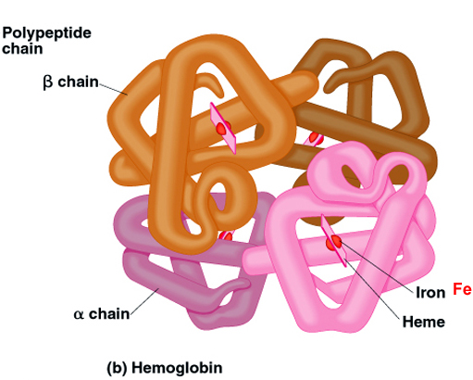

Slide 12
Bicarbonate Ion
CO₂ + H₂0 → H₂CO₃ (carbonic acid)
H₂CO₃ → H⁺ + HCO₃⁻ (bicarbonate ion)
Most of the CO₂ from internal respiration combines with water to form carbonic acid. This reaction is catalyzed by carbonic anhydrase embedded in the capillary walls. This reaction is reversible
(A small amount of CO₂ is taken up by hemoglobin to form HbCO₂ carbamino-hemoglobin)

Slide 13
External Respiration:
HbCO₂ → Hb + CO_{2 (g)↑}
carbaminohemoglobin
H⁺ + HCO₃⁻ → H₂CO₃
[At pulmonary capillaries, the enzyme carbonic anhydrase converts H₂CO₃ inside RBC to H₂O + CO_{2 (g)↑}]
H₂CO₃ → H₂O + CO_{2 (g)↑}
Hb + O_{2(g)↓} → HbO₂
deoxyhemoglobin oxyhemoglobin
[At pulmonary capillaries, O_{2(g)↓}combines with Hb in RBC to produce oxyhemoglobin]
HHb → Hb + H⁺
reduced hemoglobin

Slide 14
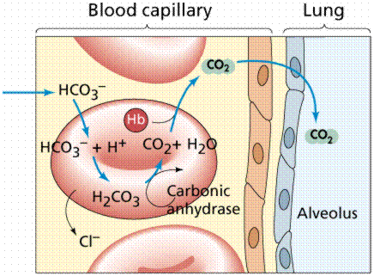
HHb
HbCO₂
Hb
O₂

Slide 15
Internal Respiration
1. HbO₂ → Hb + O₂
[oxyhemoglobin inside RBC becomes deoxyHb and O2 which leaves capillaries]
2. Hb + CO₂ → HbCO₂
[CO₂ diffuses into the blood capillaries and combines with Hb to make carbaminohemoglobin]
3. CO₂ + H₂O → H₂CO₃
[Most CO₂ uses carbonic anhydrase to combine with water to make carbonic acid]
4. H₂CO₃ → H⁺ + HCO₃⁻
5. Hb + H⁺ → HHb

Slide 16
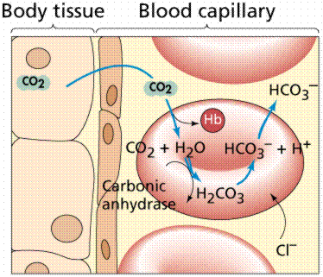
HbCO₂
Hb
HHb

Slide 18
Binding Capacity of Hemoglobin
pH and temperature affect the binding capacity of hemoglobin
Cooler temperature (37 C) and higher pH (7.40) of lungs raises oxygen binding capacity of hemoglobin to 98%
Warmer temperature (38 C) and lower pH (7.38) of body cells lowers the oxygen binding capacity of hemoglobin to 60%

Slide 19
Binding Capacity of Hemoglobin
This is important as the hemoglobin/RBC in the lung capillaries want to be able to bind as much oxygen as possible from the air in the alveoli
The hemoglobin/RBC in the body capillaries want to be able to release oxygen to the body cells and pick up carbon dioxide from the body cells

